Slide 1

[Eagle] Issue Report
Department Strategic Planning
Issued Date
2019.04.30

Slide 2
[Eagle] Issue Report_Shcedule
Category | Item | To do lists | Main | Target Date | Remark
Box | Gift Box | 2nd artwork sample shipping | FXN | 5/3 (FRI)
 |  | 2nd artwork (Design) sample SKB confirm | ALT | 5/9 (THU)
 |  | Apply for using android logo to google | FXN
 |  | Need to improvement of structure | FXN
 |  | Package reliability test complete | FXN
 |  | Gift box approval (Final artwork release) | ALT
 | Carton Box | Apply for using android logo to google | FXN
 |  | Package reliability test complete | FXN
 |  | Carton box approval (Final artwork release) | ALT
Label | Device Label | Propose an improvement of printing specifications | FXN | 5/3 (FRI)
 |  | Provide sample (Improved design + barcode printing) | FXN
 |  | SKB barcode reading test pass | ALT
 |  | Device label approval (Final artwork release) | ALT
 |  | Apply for using android logo to google | FXN
 | KC Certification Label | Provide artwork with power consumption and KC certification number | ALT | 5/27 (MON)
 |  | Provide sample with KC certification information | FXN
 |  | SKB confirm | ALT
 |  | KC certification label approval | ALT
 | Gift Box Label | Provide sample for barcode printing | FXN
 |  | SKB barcode reading test pass | ALT
 |  | Gift box label approval (Final artwork release) | ALT
 | Carton Box Label | Provide sample for barcode printing | FXN
 |  | SKB barcode reading test pass | ALT
 |  | Carton box label approval (Final artwork release) | ALT
Manual | User Manual | Provide artwork 3rd artwork | ALT |  | Need to discuss
 |  | Provide sample for 3rd artwork | FXN
 |  | 3rd artwork sample SKB confirm | ALT
 |  | Gift box approval (Final artwork release) | ALT
MD | STB Slant | Tooling modification for T2 | FXN | 5/8 (WED)
 | USB socket part | Fundamental countermeasure: mold modification for T2 | FXN | 5/8 (WED)
 | LED color | Need to prepare how to improve the LED uniformity with schedule | FXN

Slide 3
The DVT Samples

Slide 4
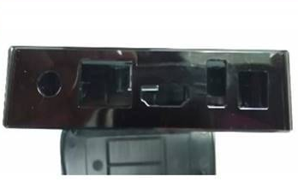
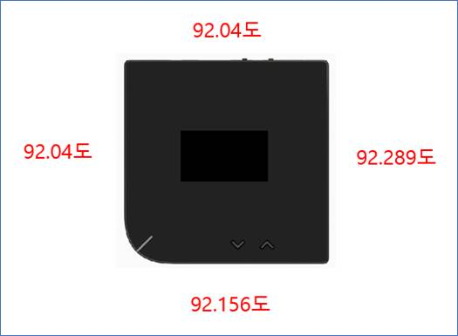
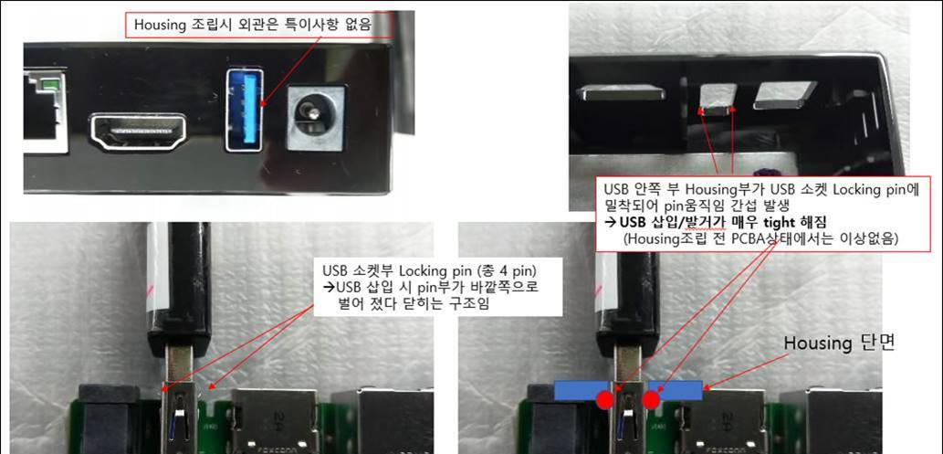
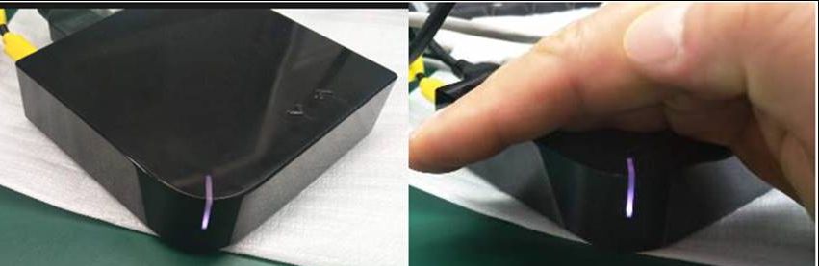
[Eagle] Issue Report_MD
2019.04.30 v0.3
○ Open ◑ Improving ● Closed
Category |  |  | Issue
No. | Item | Version | Image | Contents | Assignment | Status | Reference
01 | MD | DVT |  | Issue : STB looks like a slant Spec: 91.5+/-0.2 (DVT Sample spec out: 92.04 ~ 92.29) Next Actions: Tooling modification (Max 91.7, by T2 samples) | FXN | ○ | Required vendor to improve. Will improve from next tooling sample.
02 | MD | DVT |  | Issue : USB insertion and ignition difficult after case assembly Next Actions: 1) Temporary Measures: USB Hall Booze Cutting for DVT samples 2) Fundamental countermeasure: mold modification for T2 | FXN | ○ | Will modify USB connector position on PCBA to solve the stand out issue and plug-in/plug-out issue
03 | LED | DVT |  | Issue : LED lighting Uniformity and color is not matching Spec: White/Red/Green (ex: White looks like purple color) Next Actions: Need to prepare how to improve the LED uniformity with schedule | FXN | ○ | Will modify light pipe from next tooling sample. Have checked to color is the same on PCBA only.

Slide 5
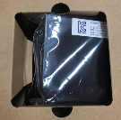
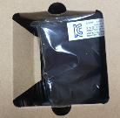
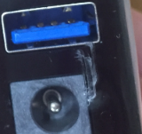
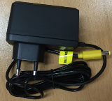
[Eagle] Issue Report_Packaging
2019.04.30 v0.3
○ Open ◑ Improving ● Closed
Category |  |  | Issue
No. | Item | Version | Image | Contents | Assignment | Status | Reference
01 | Gift Box | DVT |  | Issue : a structural weakness Next Actions: Need to improve package structure | FXN | ○ | Will improve box structure
02 | Plastic bag | DVT |  | Issue : Plastic bag Damage Next Actions: | FXN | ○ | Will remove plastic bag carefully during assembly
03 | Adapter | DVT | DVT | Issue : Missing packaging Next Actions: Plastic bag packing application | FXN | ○ | Need ALT to make the same package rule for two vendors. FXN will package ADP as what we receive

Slide 6
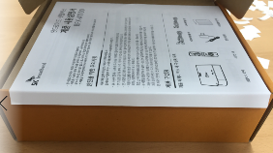


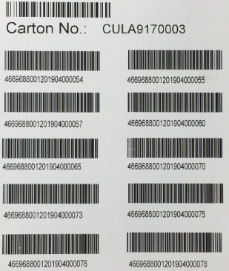
[Eagle] Issue Report_Packaging
2019.04.30 v0.3
○ Open ◑ Improving ● Closed
Category |  |  | Issue
No. | Item | Version | Image | Contents | Assignment | Status | Reference
04 | Manual | DVT |  | Issue : folding manual | FXN | ○ | Will package it more carefully
05 | Manual | DVT |  | Issue : Poor print quality | FXN | ○ | Required vendor to improve it
06 | Packing | DVT |  | Issue : Packaging order is not serial number order | FXN | ○ | Normally it will be packaged in sequence. We have mix ALT q'ty and FXN q'ty together on this DVT production.
1st sample
2nd sample

Slide 7
The 1st Sample of Gift Box

Slide 8






[Eagle] Issue Report
2019.04.15 v0.1
○ Open ◑ Improving ● Closed
Category |  |  | Issue
No. | Item | Version | Image | Contents | Assignment | Status | Reference
01 | Gift Box | 1st sample |  | Issue : Insufficient printing area Improvement : Orange print area expansion required Applying improvement to design artwork v0.4 ([Eagle_BFX-AT100] Gift_Box_Design_v0.4_190412) | ALT | ◑ | 01. Eagle_gift box_upper side.jpg
 |  |  |  |  |  |  | AT100(Android)] Gift_Box_Design_v0.4_190412
02 | Gift Box | 1st sample |  | Issue : Poor print quality Improvement : | FXN | ○ | 02. Eagle_gift box_bottom_icon.jpg
03 | Gift Box | 1st sample |  | Issue : Poor print quality Improvement : | FXN | ○ | 03. Eagle_gift box_upper side_text.jpg

Slide 9


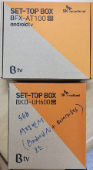
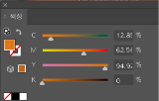

[Eagle] Issue Report
2019.04.15 v0.1
○ Open ◑ Improving ● Closed
Category |  |  | Issue
No. | Item | Version | Image | Contents | Assignment | Status | Reference
04 | Gift Box | 1st sample |  | Issue : Missing printing Improvement : | FXN | ○ | 04. Eagle_gift box_side_label_attachment_guideline.jpg
05 | Gift Box | 1st sample |  | Issue : Color difference compared to comparative model Improvement : Applying improvement to design artwork v0.4 Color change with PANTONE 158C Applying improvement to design artwork v0.4 ([Eagle_BFX-AT100] Gift_Box_Design_v0.4_190412) | ALT | ◑ | 05. Eagle_gift box_color_comparison.jpg
 |  |  |  |  |  |  | [Eagle_BFX-AT100(Android)] Gift_Box_Design_v0.4_190412
Design artwork
1st sample
1st sample
Reference

Slide 10


Thank you.

